Slide 1

Covid-19 vs. Past Pandemics
- H1N1 (2009)
- Ebola (2014-2016)
- Influenza (2009-2019)
Brent Thomas
Matt Houser

Slide 2
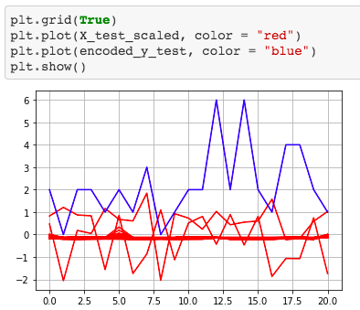

Covid-19 *Confirmed Deaths-Global*
Training Data Score: 0.754
Testing Data Score: 0.714

Slide 3
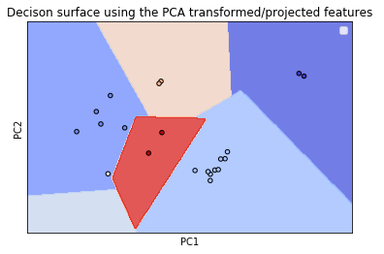
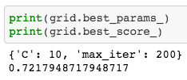
Covid-19 *Confirmed Deaths-Global*

Slide 4
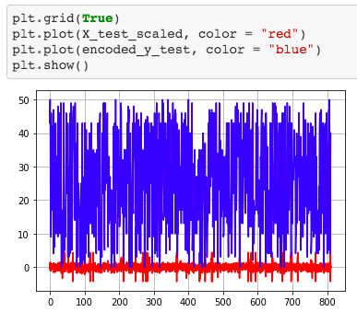

Covid-19 *Confirmed Deaths-United States*
Training Data Score: 0.934
Testing Data Score: 0.921

Slide 5
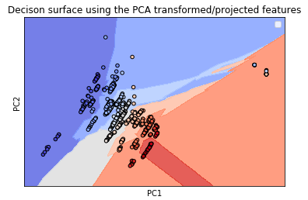

Covid-19 *Confirmed Deaths-United States*

Slide 6
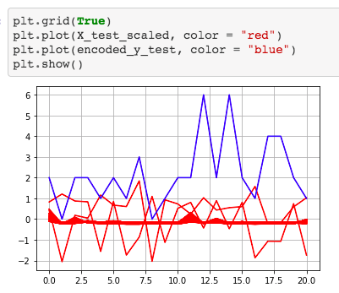

Covid-19 *Confirmed Cases-Global*
Training Data Score: 0.988
Testing Data Score: 0.986

Slide 7
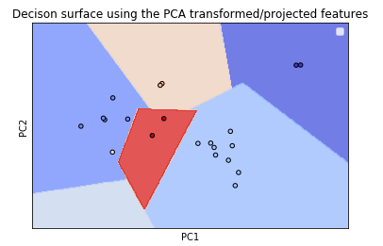
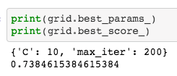
Covid-19 *Confirmed Cases-Global*

Slide 8
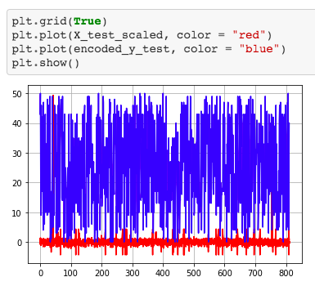

Covid-19 *Confirmed Cases-United States*
Training Data Score: 0.938
Testing Data Score: 0.912

Slide 9
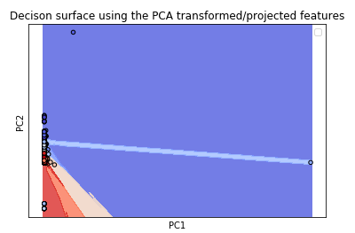
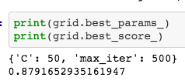
Covid-19 *Confirmed Cases-Global*

Slide 10
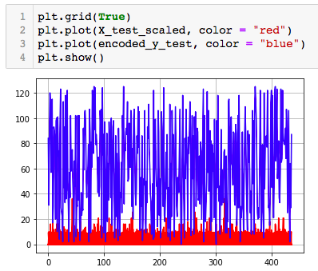

H1N1 (2009)
Training Data Score: 0.988
Testing Data Score: 0.986

Slide 11
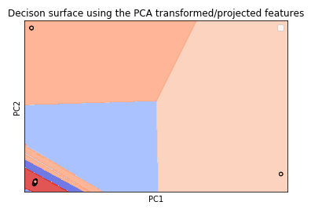

H1N1 (2009)

Slide 12
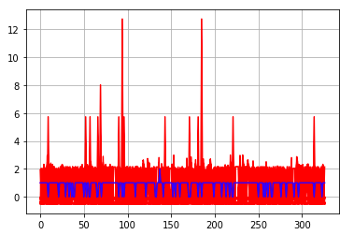
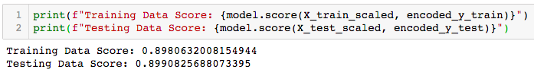
Ebola (2014-2016)
Training Data Score: 0.898
Testing Data Score: 0.899

Slide 13
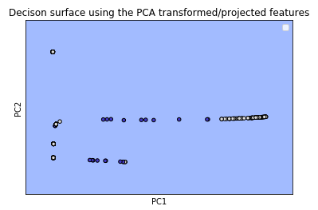
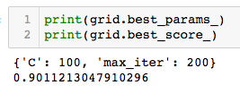
Ebola (2014-2016)

Slide 14
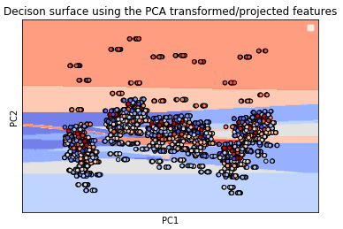
Influenza (2009-2019)

Slide 15
Influenza Total Deaths by Age (2009-2019)
65 Years and Older
64-18 Years Old
17-0 Years Old
37,421
14,269
1,424

Slide 16
United States Comparison
 | Cases | Deaths
Covid-19 | 1,132,539 | 66,369
H1N1 (2009) | 358,659 | 1,194
Ebola (2014-2016) | 967 | 242
Influenza (2009-2019) | Unknown | 159,342

Slide 17
Covid-19 Confirmed Cases (Top 10)
U.K. (4)
Russia (8)
France (5)
Germany (6)
U.S. (1)
Spain (2)
Italy (3)
Turkey (7)
Iran (10)
Brazil (9)

Slide 18
H1N1 Confirmed Cases (Top 10)
U.K. (5)
Canada(3)
U.S. (1)
Japan (7)
Mexico (2)
China (9)
Thailand (2)
Chile (4)
Argentina (8)
Australia (6)

Slide 19
Ebola Confirmed Cases (Top 10)
U.K. (9)
Spain (8)
U.S. (6)
Italy (10)
Senegal (7)
Mali (5)
Guinea (3)
Sierra Leone (1)
Liberia (2)
Nigeria (4)

Slide 20
PANDEMIC TIMELINE
H1N1
EBOLA
2009
2014
2009
Current
INFLUENZA
COVID-19

Slide 21
